Slide 1


Objects and Associative Arrays
Objects, JSON, Associative Arrays, Maps and Sets
SoftUni Team
Technical Trainers
Software University
http://softuni.bg
Notes:
© Software University Foundation – http://softuni.org
This work is licensed under the Creative Commons Attribution-NonCommercial-ShareAlike license.
<number>

Slide 2
Table of Content
Objects and JSON
Access Keys and Values
Make Objects Read Only
Iterate Over Objects Keys
The Map Class
The Set Class
2
Notes:
© Software University Foundation – http://softuni.org
This work is licensed under the Creative Commons Attribution-NonCommercial-ShareAlike license.
<number>

Slide 3
Have a Question?
sli.do
#JSCORE
3
Notes:
© Software University Foundation – http://softuni.org
This work is licensed under the Creative Commons Attribution-NonCommercial-ShareAlike license.
<number>

Slide 4
Objects in JS
Objects, Properties and JSON
3

Slide 5

Objects in JS
Objects in JavaScript hold key-value pairs:
let obj = { name : "SoftUni", age : 3 }; console.log(obj); // Object {name: "SoftUni", age: 3} obj['site'] = "https://softuni.bg"; console.log(obj); // Object {name: "SoftUni", age: 3, site: " https://softuni.bg" } delete obj.name; // Delete a property obj.site = undefined; // Delete a property value console.log(obj); // Object {age: 3, site: undefined}
<number>

Slide 6
Object Keys and Values
let course = { name: 'JS Core', hall: 'Open Source' }; let keys = Object.keys(course); console.log(keys); // [ 'name', 'hall' ] if (course.hasOwnProperty('name')) console.log(course.name); // JS Core
let values = Object.values(course); console.log(values); // [ 'JS Core', 'Open Source' ] if (values.includes('JS Core')) console.log("Found 'JS Core' value");
<number>

Slide 7
Object Freeze and Seal
let cat = { name: 'Tom', age: 5 }; Object.freeze(cat); cat.age = 10; // Error in strict mode cat.gender = 'male'; // Error in strict mode console.log(cat); // { name: 'Tom', age: 5 }
cat = { name: 'Tom', age: 5 }; Object.seal(cat); cat.age = 10; // OK delete cat.age; // Error in strict mode console.log(cat); // { name: 'Tom', age: 10 }
<number>

Slide 8


Objects and JSON
JavaScript objects can be stored as text in JSON format
JSON == JavaScript Object Notation == text object format
let obj = { name : "SoftUni", age : 3 };
let str = JSON.stringify(obj);
console.log(str); // {"name":"SoftUni","age":3}
let str = "{\"name\":\"Nakov\",\"age\":24}";
let obj = JSON.parse(str);
console.log(obj); // Object {name: "Nakov", age: 24}
<number>

Slide 9
Problem: Towns to JSON
Read an array of strings, holding towns with GPS coordinates
Parse each string to JS object (see the below format)
Print the output array of objects as JSON string
| Town | Latitude | Longitude | | Sofia | 42.696552 | 23.32601 | | Beijing | 39.913818 | 116.363625 |
[{"Town":"Sofia","Latitude":42.696552,"Longitude":23.32601}, {"Town":"Beijing","Latitude":39.913818,"Longitude":116.363625}]
<number>

Slide 10
Solution: Towns to JSON
function parseTownsToJSON(towns) { let townsArr = []; for (let town of towns.slice(1)) { let [empty, townName, lat, lng] = town.split(/\s*\|\s*/); let townObj = { Town: townName, Latitude: Number(lat), Longitude: Number(lng) }; townsArr.push(townObj); } return JSON.stringify(townsArr); }
parseTownsToJSON(['|Town|Lat|Lng|', '|Sofia |42|23|'])
Check your solution here: https://judge.softuni.bg/Contests/315
<number>

Slide 11
Nested Objects in JS
let polygon = { about: { name: "triangle", color: "red" }, corners: [{x:2, y:6}, {x:3, y:1}, {x:-2, y:2}] };
console.log(JSON.stringify(polygon)); // {"about": {"name":"triangle","color":"red"},"corners":[{"x":2,"y":6},{"x":3,"y":1},{"x":-2,"y":2}]}
console.log(polygon.about.color); // red
polygon.about.location = {x:4, y:-7};
<number>

Slide 12
Problem: Score to HTML
Read a JSON string, holding array of objects: {name, score}
Print the objects as HTML table like shown below
[{"name":"Pesho & Kiro","score":479},{"name":"Gosho, Maria & Viki","score":205}]
<table>
<tr><th>name</th><th>score</th></tr> <tr><td>Pesho &amp; Kiro</td><td>479</td></tr> <tr><td>Gosho, Maria &amp; Viki</td><td>205</td></tr>
</table>
<number>

Slide 13
Solution: Score to HTML
function scoreToHTMLTable(scoreJSON) { let html = "<table>\n"; html += " <tr><th>name</th><th>score</th>\n"; let arr = JSON.parse(scoreJSON); for (let obj of arr) html += ` <tr><td>${htmlEscape(obj['name'])}` + `</td><td>${obj['score']}</td></tr>\n`; return html + "</table>"; function htmlEscape(text) { // TODO … } }
scoreToHTMLTable([{"name":"Pesho","score":70}])
Check your solution here: https://judge.softuni.bg/Contests/315
<number>

Slide 14
Iterating Over Object Values
let laptop = { RAM: '8GB', CPU: 'i7 2.20 GHz' };
for (let key in laptop) { console.log(key); // RAM, CPU console.log(laptop[key]); // 8GB, i7 2.20 GHz }
for (let value of laptop) { // TypeError: laptop is not iterable }
<number>

Slide 15
Problem: From JSON to HTML Table
Read a JSON string, holding array of JS objects (key / value pairs)
Print the objects as HTML table like shown below
[{"Name":"Tomatoes & Chips","Price":2.35},{"Name":"J&B Chocolate","Price":0.96}]
<table> <tr><th>Name</th><th>Price</th></tr> <tr><td>Tomatoes &amp; Chips</td><td>2.35</td></tr> <tr><td>J&amp;B Chocolate</td><td>0.96</td></tr> </table>
<number>

Slide 16
Solution: From JSON to HTML Table
function JSONToHTMLTable(json) { let html = "<table>\n"; let arr = JSON.parse(json); html += " <tr>"; for (let key of Object.keys(arr[0])) html += `<th>${htmlEscape(key)}</th>`; html += "</tr>\n"; for (let obj of arr) { // TODO: print obj values in <tr><td>…</td></tr> return html + "</table>"; function htmlEscape(text) { // TODO … } }
JSONToHTMLTable(['[{"X":5,"Y":7},{"X":2,"Y":4}]'])
Check your solution here: https://judge.softuni.bg/Contests/315
<number>

Slide 17

Associative Arrays
Objects as Associative Arrays in JS

Slide 18
Associative Arrays (Maps, Dictionaries)
Associative arrays (maps / dictionaries) == arrays indexed by keys
Not by numbers 0, 1, 2, …
Hold a set of pairs {key -> value}, just like JS object
Traditional array
Traditional array
Associative array (dictionary)
Associative array (dictionary)
key
value
key
0 1 2 3 4
John Smith | +1-555-8976
Lisa Smith | +1-555-1234
Sam Doe | +1-555-5030
value
8 | -3 | 12 | 408 | 33
<number>

Slide 19

Phonebook - Associative array Example
let phonebook = { }; phonebook["John Smith"] = "+1-555-8976"; // Add phonebook["Lisa Smith"] = "+1-555-1234"; phonebook["Sam Doe"] = "+1-555-5030"; phonebook["Nakov"] = "+359-899-555-592"; phonebook["Nakov"] = "+359-2-981-9819"; // Replace
delete phonebook["John Smith"]; // Delete
console.log(Object.keys(phonebook).length); // 3
for (let key in phonebook) { // Print console.log(`${key} -> ${phonebook[key]}`); }
<number>

Slide 20
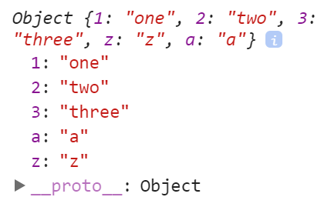
The Order of Keys in JS Object
The order of keys in JS objects in unspecified!
let obj = { "1": 'one', "3": 'three', "2": 'two', "z": 'z', "a": 'a' };
console.log(Object.keys(obj)); // ["1", "2", "3", "z", "a"]
console.log(obj); // Object {1: "one", 2: "two", 3: "three", z: "z", a: "a"}
<number>

Slide 21

Problem: Sum by Town
Read towns and incomes (like shown below) and print a JSON object holding the total income for each town (see below)
Print the towns in their natural order as object properties
Sofia 20 Varna 3 Sofia 5 Varna 4
{"Sofia":"25","Varna":"7"}
<number>

Slide 22
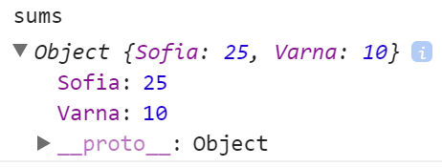
Solution: Sum of Towns
function sumOfTowns(arr) { let sums = {}; for (let i=0; i<arr.length; i+=2) { let [town, income] = [arr[i], Number(arr[i+1])]; if (sums[town] == undefined){ sums[town] = income; } else{ sums[town] += income; } } return JSON.stringify(sums); }
sumOfTowns(['Sofia','20', 'Varna','10', 'Sofia','5'])
Check your solution here: https://judge.softuni.bg/Contests/315
<number>

Slide 23
Problem: Count Word in a Text
Write a JS function to count the words in a text (case sensitive)
Words are sequence of letters, digits and _
The input text comes as array of strings
Return the output as JSON string
JS devs use Node.js for server-side JS. -- JS for devs
{"JS":3,"devs":2,"use":1,"Node":1,"js":1,"for":2,"server":1,"side":1}
<number>

Slide 24
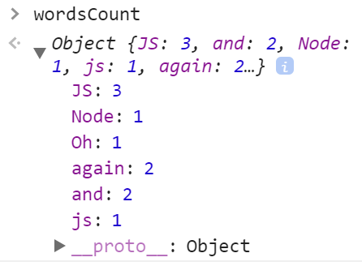
Solution: Count Words in a Text
function countWords(inputLines) { let text = inputLines.join('\n'); let words = text.split(/[^A-Za-z0-9_]+/) .filter(w => w != ''); let wordsCount = {}; for (let w of words){ wordsCount[w] ? wordsCount[w]++ : wordsCount[w] = 1; } return JSON.stringify(wordsCount); }
countWords(['JS and Node.js', 'JS again and again', 'Oh, JS?'])
Check your solution here: https://judge.softuni.bg/Contests/315
<number>

Slide 25

Live Exercises
Practice: JS Objects & JSON

Slide 26

The Map Class in JS
Key / Value Map

Slide 27
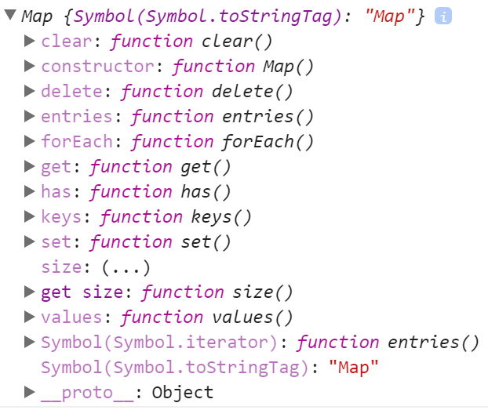
The Map Class in JS
The Map class holds { key -> value } map
Better functionality than plain JS object
let score = new Map(); score.set("Peter", 130); score.set("Maria", 85); for (let [k, v] of score){ console.log(k + ' -> ' + v); }
<number>

Slide 28
Phonebook - Map Example
let phonebook = new Map(); phonebook.set("John Smith", "+1-555-8976"); // Add phonebook.set("Lisa Smith","+1-555-1234"); phonebook.set("Sam Doe", "+1-555-5030"); phonebook.set("Nakov", "+359-899-555-592"); phonebook.set("Nakov", "+359-2-981-9819"); // Replace
phonebook.delete("John Smith"); // Delete console.log(phonebook.size); // 3
for (let [key, value] of phonebook){ // Print console.log(`${key} -> ${value}`); }
<number>

Slide 29
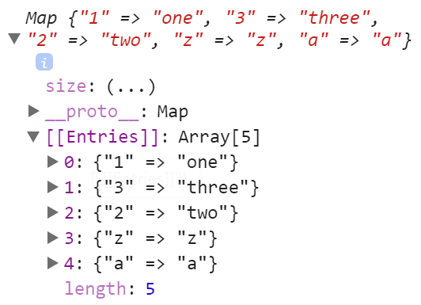
Maps Preserve the Insertion Order of Keys
let map = new Map([ ["1", 'one'], ["3", 'three'], ["2", 'two'], ["z", 'z'], ["a", 'a'] ]);
console.log(map); // Map {"1" => "one", "3" => "three", "2" => "two", "z" => "z", "a" => "a"} console.log(Array.from(map.keys())); // ["1", "3", "2", "z", "a"]
<number>

Slide 30
Problem: Count Words in a Text (with Map)
Write a JS function to count the words in a text (case sensitive)
Words are sequence of letters, digits and _
The input comes as array of strings
Order alphabetically the output words
'devs' -> 3 times 'for' -> 2 times 'js' -> 6 times 'node' -> 1 times 'server' -> 1 times 'side' -> 1 times 'use' -> 2 times
JS devs use Node.js for server-side JS. JS devs use JS. -- JS for devs --
<number>

Slide 31
Solution: Count Words in a Text (with Map)
function countWords(inputLines) { let words = inputLines.join('\n').toLowerCase() .split(/[^A-Za-z0-9_]+/).filter(w => w != ''); let wordsCount = new Map(); for (let w of words) wordsCount.has(w) ? wordsCount.set(w, wordsCount.get(w)+1) : wordsCount.set(w, 1); let allWords = Array.from(wordsCount.keys()).sort(); allWords.forEach(w => console.log(`'${w}' -> ${wordsCount.get(w)} times`)); }
countWords(['JS and Node.js', 'JS again and again', 'Oh, JS?'])
Check your solution here: https://judge.softuni.bg/Contests/315
<number>

Slide 32

Problem: Population in Towns
Read towns and populations (like shown below) and print a the towns ant their total population for each town (see below)
Print the towns in the order of their first appearance
Varna <-> 40000 Sofia <-> 1200000 Plovdiv <-> 20000 Sofia <-> 100000 Varna <-> 420000 Plovdiv <-> 400000 Plovdiv <-> 50000
Varna : 460000 Sofia : 1300000 Plovdiv : 470000
<number>

Slide 33
Solution: Population in Towns
function populationInTowns(dataRows) { let total = new Map(); for (let dataRow of dataRows) { let [town, population] = dataRow.split(/\s*<->\s*/) population = Number(population); if (total.has(town)) total.set(town, total.get(town) + population); else total.set(town, population); } for (let [town, sum] of total) console.log(town + " : " + sum); }
populationInTowns(['B<->20', 'A<->30', 'B<->5'])
Check your solution here: https://judge.softuni.bg/Contests/315
<number>

Slide 34
Problem: City Markets
Read sales data in the following format
Print for each town the sum of incomes for each product
Order the towns and products as they first appear
{town} -> {product} -> {amountOfSales}:{priceForOneUnit}
Town – Sofia $$$Laptops HP : 400000 $$$Raspberry : 300000000 $$$Audi Q7 : 20000000 Town – Montana $$$Oranges : 200000 $$$Cherries : 4000
Sofia -> Laptops HP -> 200 : 2000 Sofia -> Raspberry -> 200000 : 1500 Montana -> Oranges -> 200000 : 1 Montana -> Cherries -> 1000 : 0.3 Sofia -> Audi Q7 -> 200 : 100000
<number>

Slide 35
Solution: City Markets (Nested Maps)
function cityMarkets(sales) { let townsWithProducts = new Map(); for (let sale of sales) { let [town, product, quantityPrice] = sale.split(/\s*->\s*/); let [quantity, price] = quantityPrice.split(/\s*:\s*/); if (!townsWithProducts.has(town)) townsWithProducts.set(town, new Map()); let income = quantity * price; let oldIncome = townsWithProducts.get(town).get(product); if (oldIncome) income += oldIncome; townsWithProducts.get(town).set(product, income); } // TODO: print the incomes by towns and products }
Check your solution here: https://judge.softuni.bg/Contests/315
<number>

Slide 36

The Set Class in JS
Set of Unique Values of Any Type

Slide 37

The Set Class in JS
Sets in JS are collections of unique objects
The insertion order is preserved, with no duplicates
let names = new Set(); names.add("Peter"); names.add(20); names.add("Maria"); names.add(5);
console.log(names.has('Peter')); // true
names.add("Maria"); // Duplicates are skipped
names.delete(20); // Delete element if exists
for (let name of names) console.log(name);
<number>

Slide 38
Problem: Extract Unique Words
Write a JS function to extract all unique words from a text (case insensitive)
Words are sequences of letters, digits and _
The input comes as array of strings
The output should hold the words in their order of appearance
JS devs use Node.js for server-side JS. JS devs use JS. -- JS for devs --
js, devs, use, node, for, server, side
<number>

Slide 39
Solution: Extract Unique Words
function extractWords(inputSentences) { let wordPattern = /\b[a-zA-Z0-9_]+\b/g; let words = new Set(); for (let sentence of inputSentences) { let matches = sentence.match(wordPattern); matches.forEach(x=>words.add(x.toLowerCase())); } console.log([...words.values()].join(", ")); }
extractWords(['JS and Node.js', 'JS again and again', 'Oh, JS?'])
Check your solution here: https://judge.softuni.bg/Contests/315
<number>

Slide 40
Live Exercises
Practice: Using Maps and Sets

Slide 41

Summary
Objects in JS hold key-value pairs
Maps map key to values, preserve key order
Sets hold unique collection of values
…
…
…
let obj = { name : "SoftUni", age : 3 };
obj.age++;
obj[town] = 'Sofia';
delete obj.name;
let map = new Map();
map.set('score', 20);
let map = new Set(); set.add(5);
41
Notes:
© Software University Foundation – http://softuni.org
This work is licensed under the Creative Commons Attribution-NonCommercial-ShareAlike license.
<number>

Slide 42
https://softuni.bg/trainings/2080/js-fundamentals-september-2018
Notes:
© Software University Foundation – http://softuni.org
This work is licensed under the Creative Commons Attribution-NonCommercial-ShareAlike license.
<number>

Slide 43













SoftUni Diamond Partners

Slide 44





SoftUni Organizational Partners

Slide 45




Trainings @ Software University (SoftUni)
Software University – High-Quality Education and Employment Opportunities
softuni.bg
Software University Foundation
http://softuni.foundation/
Software University @ Facebook
facebook.com/SoftwareUniversity
Software University Forums
forum.softuni.bg
Notes:
© Software University Foundation – http://softuni.org
This work is licensed under the Creative Commons Attribution-NonCommercial-ShareAlike license.
<number>

Slide 46

License
This course (slides, examples, demos, videos, homework, etc.) is licensed under the "Creative Commons Attribution-NonCommercial-ShareAlike 4.0 International" license
46
Notes:
© Software University Foundation – http://softuni.org
This work is licensed under the Creative Commons Attribution-NonCommercial-ShareAlike license.
<number>

